Slide 1
Basics of Probability and Statistics
K. Ramachandra Murthy
http://www.isical.ac.in/~k.ramachandra/PR_Course.htm

Slide 2
Outline
Probability
Statistical Measures

Slide 3
Probability

Slide 4
Idea of Probability
Probability is the science of chance behavior
Chance behavior is unpredictable in the short run but has a regular and predictable pattern in the long run

Slide 5
Randomness
Random: individual outcomes are uncertain
But there is a regular distribution of outcomes in a large number of repetitions.
Example: select any number from a bag of numbers {1,2,3,…,100}

Slide 6
Random Experiment…
If an experiment has n possible outcomes [all equally likely to occur].
…a random experiment is an action or process that leads to one of several possible outcomes. For example:
Experiment | Outcomes
Flip a coin | Heads, Tails
Selecting a color ball | Green, red, blue
Rolling a die | 1,2,3,4,5,6
Picking a card from a deck | 52 cards

Slide 7
Relative-Frequency Probabilities
Relative frequency (proportion of occurrences) of an outcome settles down to one value over the long run. That one value is then defined to be the probability of that outcome.
Can be determined (or checked) by observing a long series of independent trials (empirical data)
  experience with many samples
  simulation

Slide 8
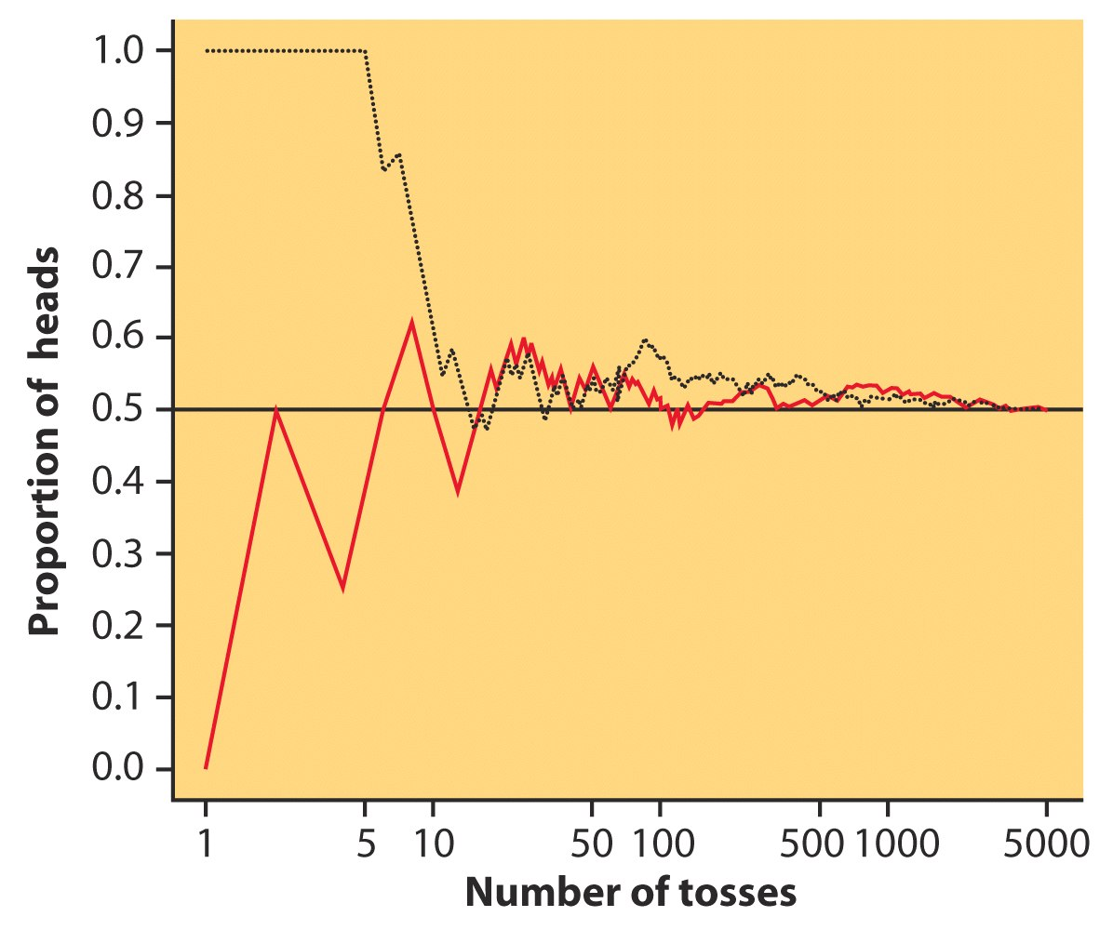
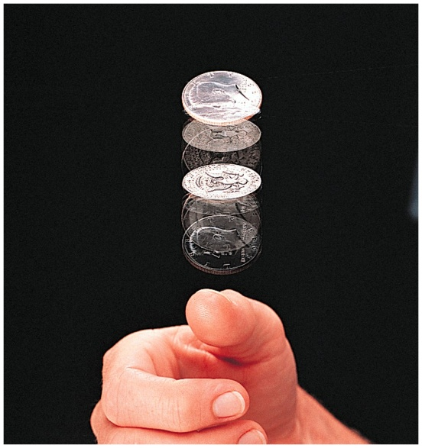
Relative-Frequency Probabilities
Coin flipping:

Slide 9
Probability Models
The sample space S of a random phenomenon is the set of all possible outcomes.
An event is an outcome or a set of outcomes (subset of the sample space).
A probability model is a mathematical description of long-run regularity consisting of a sample space S and a way of assigning probabilities to events.

Slide 10
Sample Space and Events
Sample Space
Event 3
Event 4
Event 1
Event 5
Event 2

Slide 11

Example
Sample Space ={1,2,3,4,5,6}
Rolling an odd number={2,4,6}
Rolling an even number={2,4,6}
Rolling a prime number={2,3,5}

Slide 12
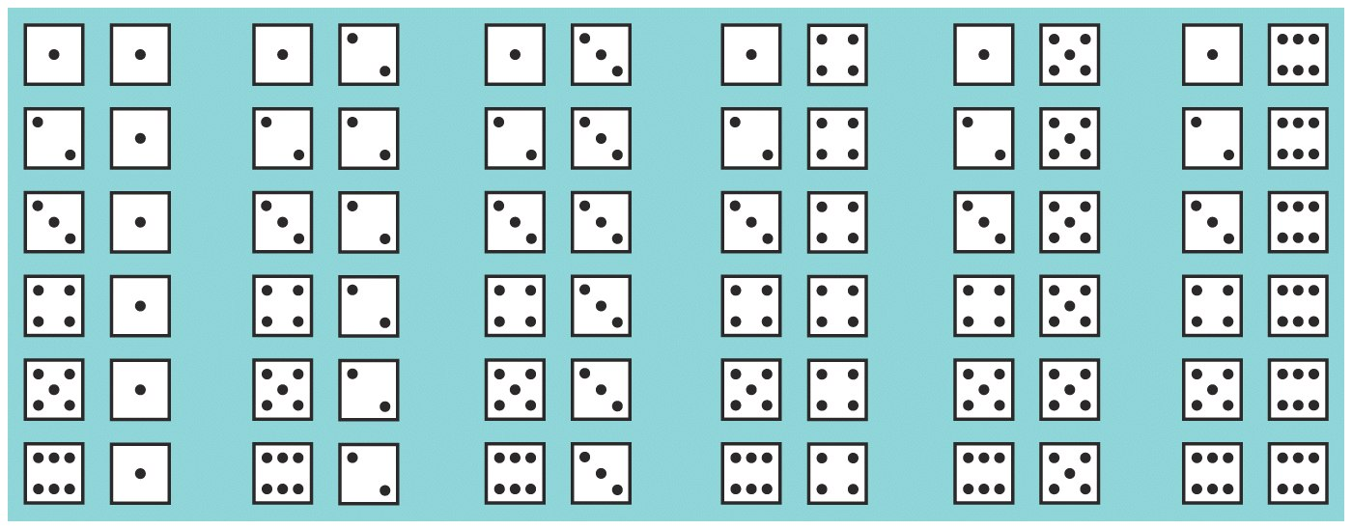
Probability Model for Two Dice
Random phenomenon: roll pair of fair dice.
Sample space:
Event: rolling even numbers on both dice

Slide 13
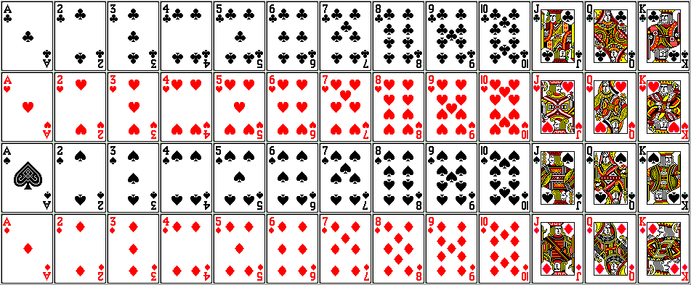
Probability Model for 52 card deck
Random phenomenon: Arrange 52 card deck in a zigzag way
Sample space:
Event: pick an ace

Slide 14
Probability
What is a PROBABILITY?
- Probability is the chance that some event will happen
- It is the ratio of the number of ways a certain event can occur to the number of possible outcomes

Slide 15
Probability
What is a PROBABILITY?
number of favorable outcomes
number of possible outcomes
Examples that use Probability:
(1) Dice, (2) Spinners, (3) Coins, (4) Deck of Cards, (5) Evens/Odds, (6) Alphabet, etc.
P(event) =

Slide 16
Probability
What is a PROBABILITY?
0 ¼ or .25 ½ or .5 ¾ or .75 1
Impossible Not Very Equally Likely Somewhat Certain
Likely Likely

Slide 17
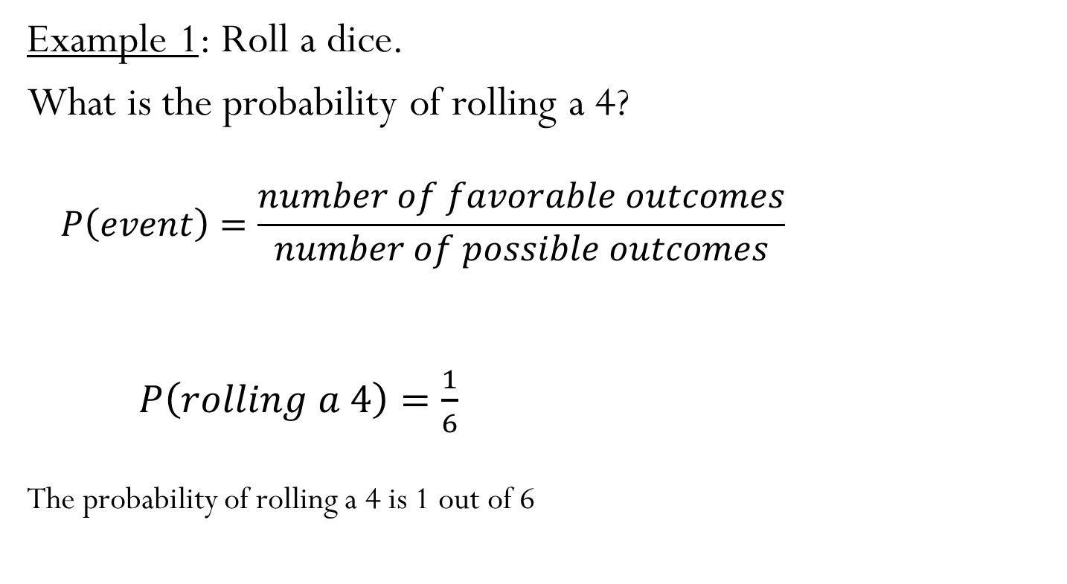
Probability of Simple Events

Slide 18
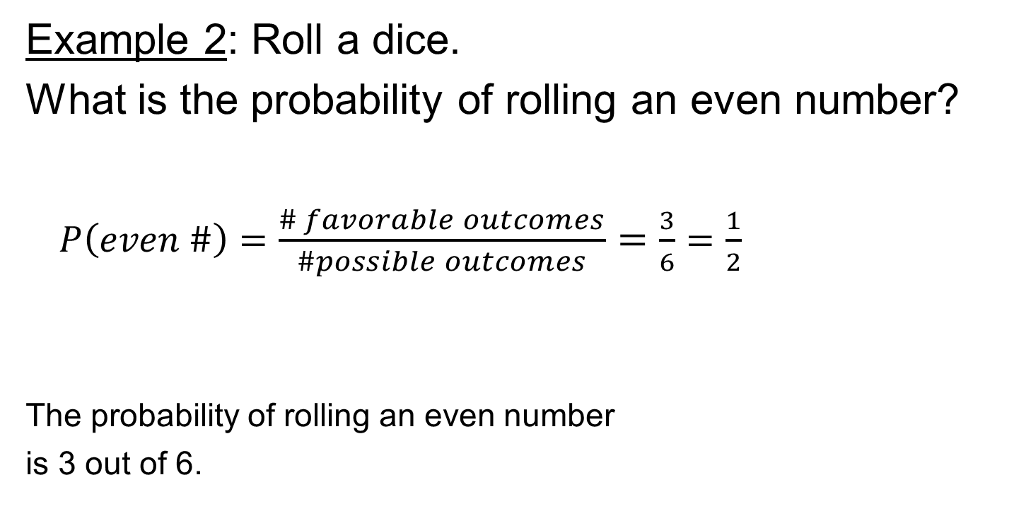
Probability of Simple Events
Example 2: Roll a dice.
What is the probability of rolling an even number?
$P\left(even \#\right)=\frac{\# favorable outcomes}{\#possible outcomes}=\frac{3}{6}=\frac{1}{2}$
The probability of rolling an even number
is 3 out of 6.

Slide 19
Probability of Simple Events
Example 3: Roll a dice.
Random phenomenon: roll pair of fair dice and count the number of pips on the up-faces.
Find the probability of rolling a 5.
P(roll a 5) = P( )+P( )+P( )+P( )
= 1/36 + 1/36 + 1/36 + 1/36
= 4/36
= 0.111

Slide 20

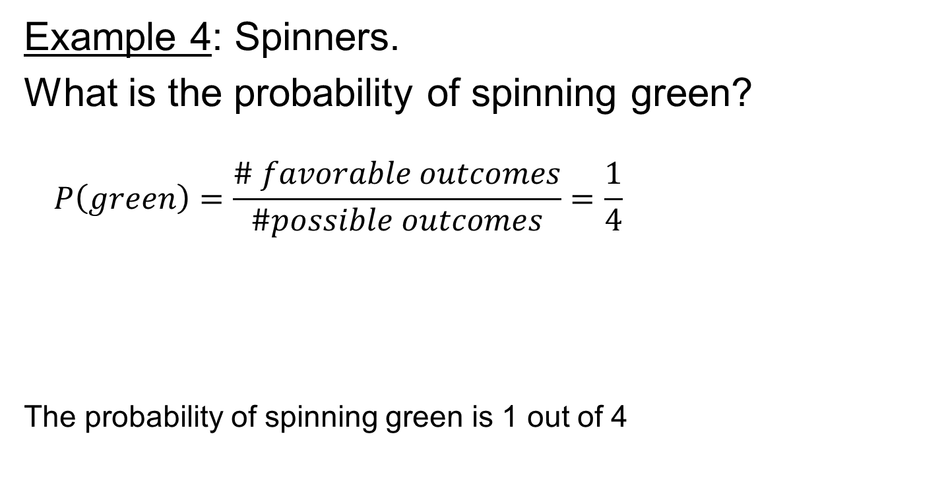
Probability of Simple Events
Example 4: Spinners.
What is the probability of spinning green?
$$P\left(green\right)=\frac{\# favorable outcomes}{\#possible outcomes}=\frac{1}{4}$$
The probability of spinning green is 1 out of 4

Slide 21
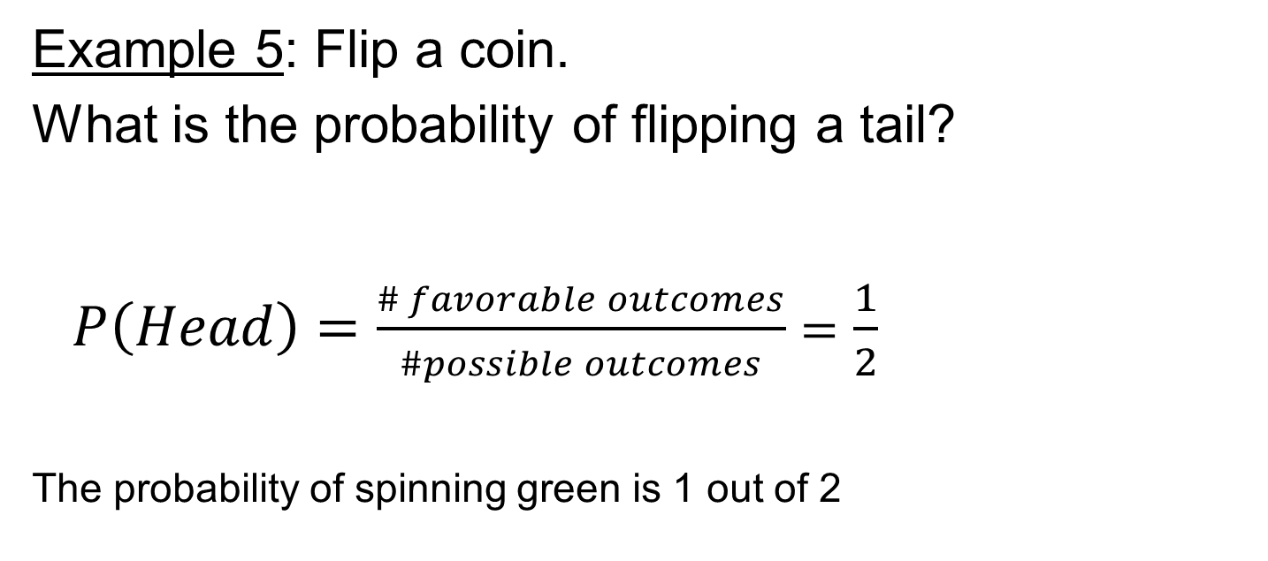
Probability of Simple Events
Example 5: Flip a coin.
What is the probability of flipping a tail?
$P\left(Head\right)=\frac{\# favorable outcomes}{\#possible outcomes}=\frac{1}{2}$
The probability of spinning green is 1 out of 2

Slide 22

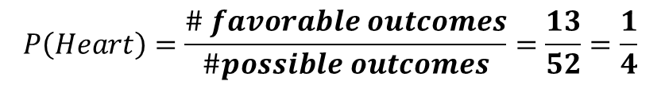
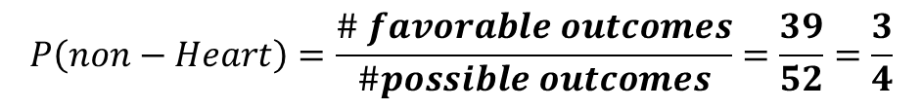
Probability of Simple Events
Example 6: Deck of Cards.
What is the probability of picking a heart?
The probability of picking a heart is 1 out of 4
What is the probability of picking a non heart?
The probability of picking a heart is 3 out of 4
$$P\left(Heart\right)=\frac{\# favorable outcomes}{\#possible outcomes}=\frac{13}{52}=\frac{1}{4}$$
$$P\left(non−Heart\right)=\frac{\# favorable outcomes}{\#possible outcomes}=\frac{39}{52}=\frac{3}{4}$$

Slide 23
Probability of Simple Events
Key Concepts:
- Probability is the chance that some event will happen
- It is the ratio of the number of ways a certain even can occur to the total number of possible outcomes

Slide 24
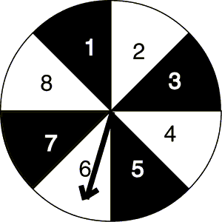
Probability of Simple Events
Guided Practice: Calculate the probability of each independent event.
1) P(black) =
2) P(1) =
3) P(odd) =
4) P(prime) =

Slide 25
Probability of Simple Events
Guided Practice: Answers
1) P(black) = 4/8
2) P(1) = 1/8
3) P(odd) = 1/2
4) P(prime) = 1/2

Slide 26
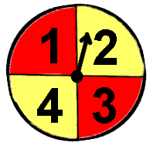
Probability of Simple Events
Independent Practice: Calculate the probability of each independent event.
1) P(red) =
2) P(2) =
3) P(not red) =
4) P(even) =

Slide 27
Probability of Simple Events
Independent Practice: Answers
1) P(red) =1/2
2) P(2) = 1/4
3) P(not red) = 1/2
4) P(even) = 1/2

Slide 28
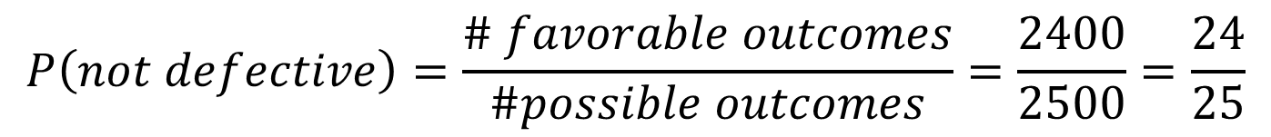
Probability of Simple Events
Real World Example:
A computer company manufactures 2,500 computers each day. An average of 100 of these computers are returned with defects. What is the probability that the computer you purchased is not defective?
$$P\left(not defective\right)=\frac{\# favorable outcomes}{\#possible outcomes}=\frac{2400}{2500}=\frac{24}{25}$$

Slide 29
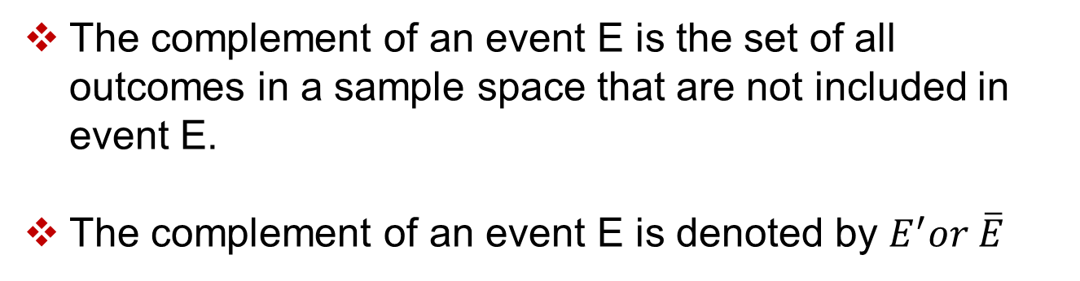
Complementary Events
The complement of an event E is the set of all outcomes in a sample space that are not included in event E.
The complement of an event E is denoted by $E^{′}or \overline{E}$
Properties of Probability:

Slide 30
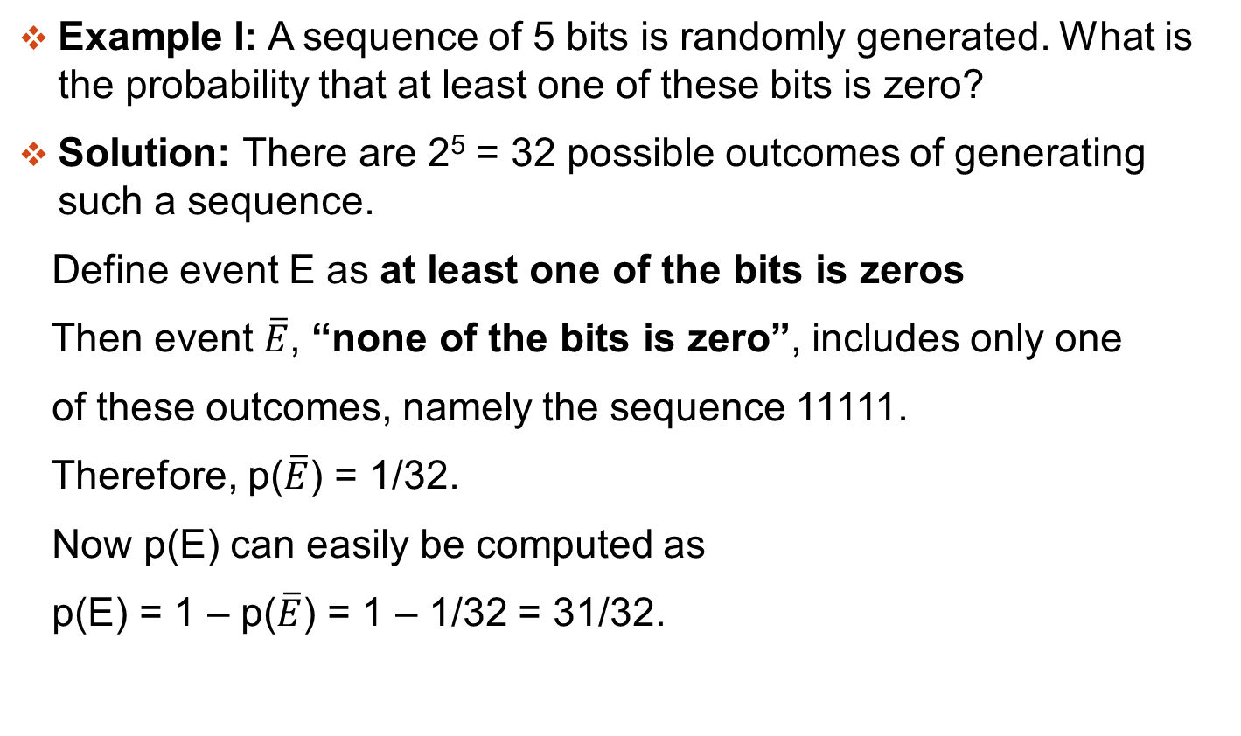
Complementary Events
Example I: A sequence of 5 bits is randomly generated. What is the probability that at least one of these bits is zero?
Solution: There are 2⁵ = 32 possible outcomes of generating such a sequence.
Define event E as at least one of the bits is zeros
Then event $\overline{E}$, “none of the bits is zero”, includes only one
of these outcomes, namely the sequence 11111.
Therefore, p($\overline{E}$) = 1/32.
Now p(E) can easily be computed as
p(E) = 1 – p($\overline{E}$) = 1 – 1/32 = 31/32.

Slide 31
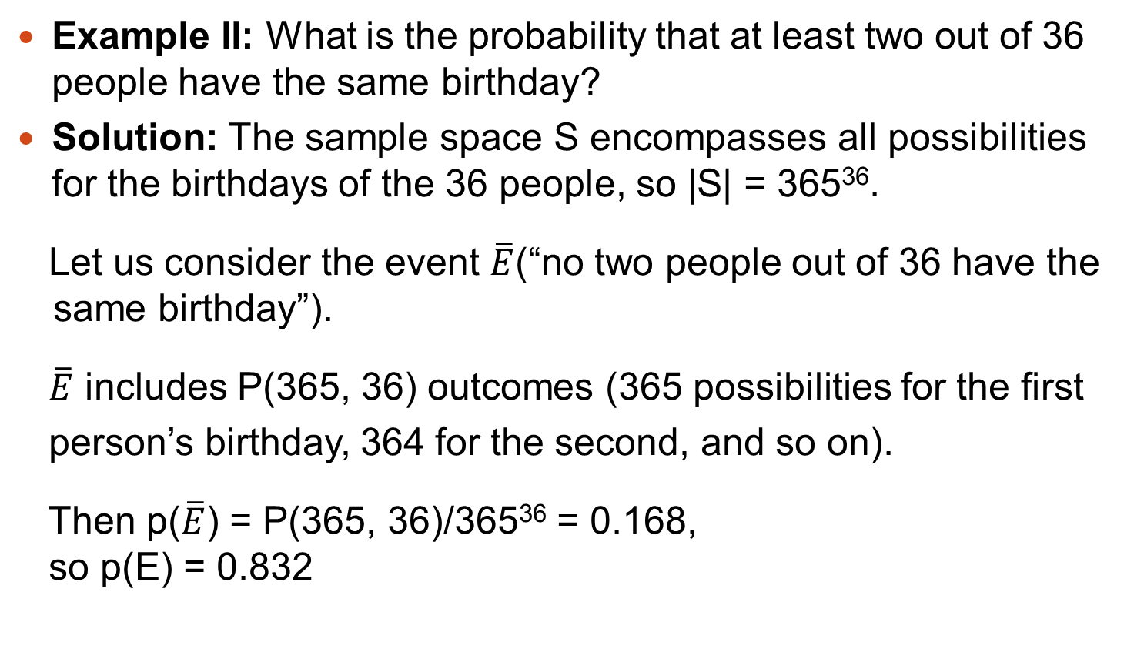
Complementary Events
Example II: What is the probability that at least two out of 36 people have the same birthday?
Solution: The sample space S encompasses all possibilities for the birthdays of the 36 people, so |S| = 365³⁶.
Let us consider the event $\overline{E}$(“no two people out of 36 have the same birthday”).
$\overline{E}$ includes P(365, 36) outcomes (365 possibilities for the first
person’s birthday, 364 for the second, and so on).
Then p($\overline{E}$) = P(365, 36)/365³⁶ = 0.168,
so p(E) = 0.832

Slide 32
The Multiplication Rule
If events A and B are independent, then the probability of two events, A and B occurring in a sequence (or simultaneously) is:
This rule can extend to any number of independent events.
Two events are independent if the occurrence of the first event does not affect the probability of the occurrence of the second event.

Slide 33
Mutually Exclusive
Two events A and B are mutually exclusive if and only if:
In a Venn diagram this means that event A is disjoint from event B.
A and B are M.E.
A and B are not M.E.

Slide 34
The Addition Rule
The probability that at least one of the events A or B will occur, P(A or B), is given by:
If events A and B are mutually exclusive, then the addition rule is simplified to:
This simplified rule can be extended to any number of mutually exclusive events.

Slide 35
The Addition and Multiplication Rule
Example: What is the probability of a positive integer selected at random from the set of positive integers {1,2,….,100} to be divisible by 2 or 5?
Solution:
E₂: “integer is divisible by 2”
E₅: “integer is divisible by 5”
    E₂ = {2, 4, 6, …, 100} and |E₂| = 50
p(E₂) = 0.5
    E₅ = {5, 10, 15, …, 100} and|E₅| = 20
p(E₅) = 0.2

Slide 36
The Addition and Multiplication Rule
    E₂ ∩ E₅ = {10, 20, 30, …, 100} and |E₂ ∩ E₅| = 10
p(E₂ ∩ E₅) = 0.1
    p(E₂ ∪ E₅) = p(E₂) + p(E₅) – p(E₂ ∩ E₅ )
p(E₂ ∪ E₅) = 0.5 + 0.2 – 0.1 = 0.6

Slide 37
Conditional Probability
We talk about conditional probability when the probability of one event depends on whether or not another event has occurred.
e.g. There are 2 red and 3 blue counters in a bag and, without looking, we take out one counter and do not replace it.
The probability of a 2nd counter taken from the bag being red depends on whether the 1st was red or blue.
Conditional probability problems can be solved by considering the individual possibilities or by using a table, a Venn diagram, a tree diagram or a formula.

Slide 38
Notation
P(A B) means
“the probability that event A occurs given that B has occurred”. This is conditional probability.

Slide 39
Example
e.g. 1. The following table gives data on the type of car, grouped by petrol consumption, owned by 100 people.
One person is selected at random.
L is the event “the person owns a low rated car”
Low
Medium
High
Total
Male
12
33
7
Female
23
21
4
100

Slide 40
Example
e.g. 1. The following table gives data on the type of car, grouped by petrol consumption, owned by 100 people.
One person is selected at random.
L is the event “the person owns a low rated car”
F is the event “a female is chosen”.
Low
Medium
High
Total
Male
12
33
7
Female
23
21
4
100

Slide 41
e.g. 1. The following table gives data on the type of car, grouped by petrol consumption, owned by 100 people.
Low
Medium
High
Total
Male
12
33
7
Female
23
21
4
One person is selected at random.
100
L is the event “the person owns a low rated car”
F is the event “a female is chosen”.

Slide 42
e.g. 1. The following table gives data on the type of car, grouped by petrol consumption, owned by 100 people.
Low
Medium
High
Total
Male
12
33
7
Female
23
21
4
One person is selected at random.
100
L is the event “the person owns a low rated car”
F is the event “a female is chosen”.
Find (i) P(L) (ii) P(F and L) (iii) P(F L)
We need to be careful which row or column we look at.

Slide 43
Low
Solution:
Low
Medium
High
Total
Male
12
12
33
7
Female
23
23
21
4
35
100
100
Find (i) P(L) (ii) P(F and L) (iii) P(F L)
(i) P(L) =

Slide 44
Solution:
Low
Medium
High
Total
Male
12
33
7
Female
23
23
21
4
100
100
Find (i) P(L) (ii) P(F and L) (iii) P(F L)
(i) P(L) =
(ii) P(F and L) =
The probability of selecting a female with a low rated car.

Slide 45
Solution:
Low
Medium
High
Total
Male
12
12
33
7
Female
23
23
21
4
35
100
Find (i) P(L) (ii) P(F and L) (iii) P(F L)
(i) P(L) =
(ii) P(F and L) =
We must be careful with the denominators in (ii) and (iii). Here we are given the car is low rated. We want the total of that column.
(iii) P(F L) =
The probability of selecting a female given the car is low rated.

Slide 46
Solution:
Low
Medium
High
Total
Male
12
33
7
Female
23
21
4
100
Find (i) P(L) (ii) P(F and L) (iii) P(F L)
(i) P(L) =
Notice that
(ii) P(F and L) =
P(L) × P(F L)
(iii) P(F L) =
= P(F and L)
So, P(F and L) = P(F L) × P(L)

Slide 47
Conditional Probability
P(F and L) = P(F L) × P(L)
This result can be used to help solve harder conditional probability problems.
However, I haven’t proved the formula, just shown that it works for one particular problem.
We’ll just illustrate it again on a simple problem using a Venn diagram.

Slide 48
e.g. 2. I have 2 packets of seeds. One contains 20 seeds and although they look the same, 8 will give red flowers and 12 blue. The 2nd packet has 25 seeds of which 15 will be red and 10 blue.
Draw a Venn diagram and use it to illustrate the conditional probability formula.
Solution: Let R be the event “ Red flower ” and F be the event “ First packet ”
F
R
Red in the 1st packet

Slide 49
e.g. 2. I have 2 packets of seeds. One contains 20 seeds and although they look the same, 8 will give red flowers and 12 blue. The 2nd packet has 25 seeds of which 15 will be red and 10 blue.
Draw a Venn diagram and use it to illustrate the conditional probability formula.
Solution: Let R be the event “ Red flower ” and F be the event “ First packet ”
F
R
8
Red in the 1st packet

Slide 50
e.g. 2. I have 2 packets of seeds. One contains 20 seeds and although they look the same, 8 will give red flowers and 12 blue. The 2nd packet has 25 seeds of which 15 will be red and 10 blue.
Draw a Venn diagram and use it to illustrate the conditional probability formula.
Solution: Let R be the event “ Red flower ” and F be the event “ First packet ”
F
R
8
Blue in the 1st packet

Slide 51
e.g. 2. I have 2 packets of seeds. One contains 20 seeds and although they look the same, 8 will give red flowers and 12 blue. The 2nd packet has 25 seeds of which 15 will be red and 10 blue.
Draw a Venn diagram and use it to illustrate the conditional probability formula.
Solution: Let R be the event “ Red flower ” and F be the event “ First packet ”
F
R
12
8
Blue in the 1st packet

Slide 52
e.g. 2. I have 2 packets of seeds. One contains 20 seeds and although they look the same, 8 will give red flowers and 12 blue. The 2nd packet has 25 seeds of which 15 will be red and 10 blue.
Draw a Venn diagram and use it to illustrate the conditional probability formula.
Solution: Let R be the event “ Red flower ” and F be the event “ First packet ”
F
R
12
8
Red in the 2nd packet

Slide 53
e.g. 2. I have 2 packets of seeds. One contains 20 seeds and although they look the same, 8 will give red flowers and 12 blue. The 2nd packet has 25 seeds of which 15 will be red and 10 blue.
Draw a Venn diagram and use it to illustrate the conditional probability formula.
Solution: Let R be the event “ Red flower ” and F be the event “ First packet ”
F
R
12
8
15
Red in the 2nd packet

Slide 54
e.g. 2. I have 2 packets of seeds. One contains 20 seeds and although they look the same, 8 will give red flowers and 12 blue. The 2nd packet has 25 seeds of which 15 will be red and 10 blue.
Draw a Venn diagram and use it to illustrate the conditional probability formula.
Solution: Let R be the event “ Red flower ” and F be the event “ First packet ”
F
R
12
8
15
Blue in the 2nd packet

Slide 55
e.g. 2. I have 2 packets of seeds. One contains 20 seeds and although they look the same, 8 will give red flowers and 12 blue. The 2nd packet has 25 seeds of which 15 will be red and 10 blue.
Draw a Venn diagram and use it to illustrate the conditional probability formula.
Solution: Let R be the event “ Red flower ” and F be the event “ First packet ”
F
R
12
8
15
10
Blue in the 2nd packet

Slide 56
e.g. 2. I have 2 packets of seeds. One contains 20 seeds and although they look the same, 8 will give red flowers and 12 blue. The 2nd packet has 25 seeds of which 15 will be red and 10 blue.
Draw a Venn diagram and use it to illustrate the conditional probability formula.
Solution: Let R be the event “ Red flower ” and F be the event “ First packet ”
F
R
12
8
15
Total: 20 + 25
10

Slide 57
e.g. 2. I have 2 packets of seeds. One contains 20 seeds and although they look the same, 8 will give red flowers and 12 blue. The 2nd packet has 25 seeds of which 15 will be red and 10 blue.
Draw a Venn diagram and use it to illustrate the conditional probability formula.
Solution: Let R be the event “ Red flower ” and F be the event “ First packet ”
45
F
R
12
8
15
Total: 20 + 25
10

Slide 58
e.g. 2. I have 2 packets of seeds. One contains 20 seeds and although they look the same, 8 will give red flowers and 12 blue. The 2nd packet has 25 seeds of which 15 will be red and 10 blue.
Draw a Venn diagram and use it to illustrate the conditional probability formula.
Solution: Let R be the event “ Red flower ” and F be the event “ First packet ”
45
F
R
12
8
15
10

Slide 59
e.g. 2. I have 2 packets of seeds. One contains 20 seeds and although they look the same, 8 will give red flowers and 12 blue. The 2nd packet has 25 seeds of which 15 will be red and 10 blue.
Draw a Venn diagram and use it to illustrate the conditional probability formula.
Solution: Let R be the event “ Red flower ” and F be the event “ First packet ”
45
P(R and F) =
R
F
12
8
15
10

Slide 60
e.g. 2. I have 2 packets of seeds. One contains 20 seeds and although they look the same, 8 will give red flowers and 12 blue. The 2nd packet has 25 seeds of which 15 will be red and 10 blue.
Draw a Venn diagram and use it to illustrate the conditional probability formula.
Solution: Let R be the event “ Red flower ” and F be the event “ First packet ”
45
P(R and F) =
R
F
12
8
15
10

Slide 61
e.g. 2. I have 2 packets of seeds. One contains 20 seeds and although they look the same, 8 will give red flowers and 12 blue. The 2nd packet has 25 seeds of which 15 will be red and 10 blue.
Draw a Venn diagram and use it to illustrate the conditional probability formula.
Solution: Let R be the event “ Red flower ” and F be the event “ First packet ”
45
P(R and F) =
R
F
12
8
15
10

Slide 62
e.g. 2. I have 2 packets of seeds. One contains 20 seeds and although they look the same, 8 will give red flowers and 12 blue. The 2nd packet has 25 seeds of which 15 will be red and 10 blue.
Draw a Venn diagram and use it to illustrate the conditional probability formula.
Solution: Let R be the event “ Red flower ” and F be the event “ First packet ”
45
P(R and F) =
R
F
P(R F) =
12
8
15
10

Slide 63
e.g. 2. I have 2 packets of seeds. One contains 20 seeds and although they look the same, 8 will give red flowers and 12 blue. The 2nd packet has 25 seeds of which 15 will be red and 10 blue.
Draw a Venn diagram and use it to illustrate the conditional probability formula.
Solution: Let R be the event “ Red flower ” and F be the event “ First packet ”
45
P(R and F) =
R
F
P(R F) =
P(F) =
12
8
15
10

Slide 64
e.g. 2. I have 2 packets of seeds. One contains 20 seeds and although they look the same, 8 will give red flowers and 12 blue. The 2nd packet has 25 seeds of which 15 will be red and 10 blue.
Draw a Venn diagram and use it to illustrate the conditional probability formula.
Solution: Let R be the event “ Red flower ” and F be the event “ First packet ”
45
P(R and F) =
R
F
P(R F) =
P(F) =
12
8
15
10

Slide 65
e.g. 2. I have 2 packets of seeds. One contains 20 seeds and although they look the same, 8 will give red flowers and 12 blue. The 2nd packet has 25 seeds of which 15 will be red and 10 blue.
Draw a Venn diagram and use it to illustrate the conditional probability formula.
Solution: Let R be the event “ Red flower ” and F be the event “ First packet ”
45
P(R and F) =
R
F
P(R F) =
P(F) =
12
8
15
10

Slide 66
e.g. 2. I have 2 packets of seeds. One contains 20 seeds and although they look the same, 8 will give red flowers and 12 blue. The 2nd packet has 25 seeds of which 15 will be red and 10 blue.
Draw a Venn diagram and use it to illustrate the conditional probability formula.
Solution: Let R be the event “ Red flower ” and F be the event “ First packet ”
45
P(R and F) =
R
F
P(R F) =
P(F) =
12
8
15
10
P(R F) × P(F) =
So,
P(R and F) = P(R F) × P(F)

Slide 67
Summary
The probability that both event A and event B occur is given by
P(A and B) = P(A B) × P(B)
We often use this in the form
P(A B) =
P(A and B)
P(B)
In words, this is “the probability of event A given that B has occurred, equals the probability of both A and B occurring divided by the probability of B”.
Reminder:
P(A and B) can also be written as P(A ∩ B)

Slide 68
Example
Three jars contain colored balls as described in the table below.
  One jar is chosen at random and a ball is selected. If the ball is red, what is the probability that it came from the 2nd jar?
Jar # | Red | White | Blue
1 | 3 | 4 | 1
2 | 1 | 2 | 3
3 | 4 | 3 | 2

Slide 69
Example
We will define the following events:
  J₁ is the event that first jar is chosen
  J₂ is the event that second jar is chosen
  J₃ is the event that third jar is chosen
  R is the event that a red ball is selected

Slide 70
Example
The events J₁ , J₂ , and J₃ mutually exclusive
  Why?
    You can’t chose two different jars at the same time
Because of this, our sample space has been divided or partitioned along these three events

Slide 71
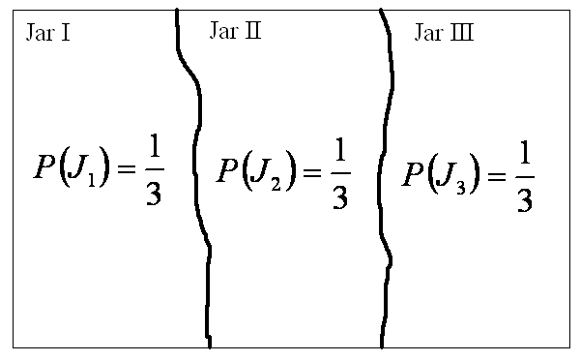
Venn Diagram
Let’s look at the Venn Diagram

Slide 72
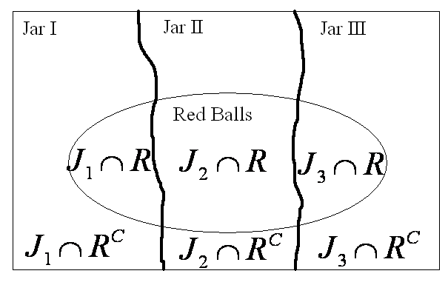
Venn Diagram
All of the red balls are in the first, second, and third jar so their set overlaps all three sets of our partition

Slide 73
Finding Probabilities
What are the probabilities for each of the events in our sample space?
How do we find them?

Slide 74
Computing Probabilities
Similar calculations show:

Slide 75
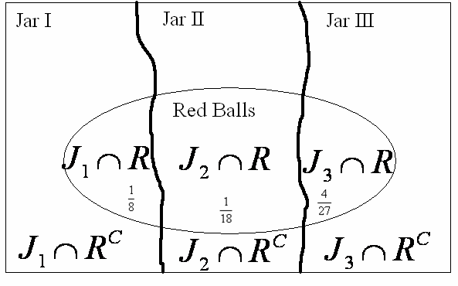
Venn Diagram
Updating our Venn Diagram with these probabilities:

Slide 76
Where are we going with this?
Our original problem was:
  One jar is chosen at random and a ball is selected. If the ball is red, what is the probability that it came from the 2nd jar?
In terms of the events we’ve defined we want:

Slide 77
Finding our Probability
We already know what the numerator portion is from our Venn Diagram
What is the denominator portion?

Slide 78
Arithmetic!
Plugging in the appropriate values:

Slide 79
Bayes’ Theorem:
The important consequence of Bayes’ Theorem is that it relates inverse probabilities: P(A|B) and P(B|A)

Slide 80
Random Variables
A random variable is a variable whose value is a numerical outcome of a random experiment
  often denoted with capital alphabetic symbols (X, Y, etc.)
  a normal random variable may be denoted as X ~ N(µ, σ)
The probability distribution of a random variable X tells us what values X can take and how to assign probabilities to those values

Slide 81
Discrete Random Variables
Random variables that have a finite (countable) list of possible outcomes, with probabilities assigned to each of these outcomes, are called discrete
Discrete random variables
  number of pets owned (0, 1, 2, … )
  numerical day of the month (1, 2, …, 31)
  the total number of tails you get if you flip 100 coins

Slide 82
Discrete example: roll of a die
p(x)
1/6
x
1
2
3
4
5
6

Slide 83
Probability Distribution Function (PDF)
x
p(x)
1
p(x=1)=1/6
2
p(x=2)=1/6
3
p(x=3)=1/6
4
p(x=4)=1/6
5
p(x=5)=1/6
6
p(x=6)=1/6
1.0

Slide 84
Cumulative Distribution Function (CDF)
1.0
P(x)
5/6
2/3
1/2
1/3
1/6
1
2
3
4
5
6
x

Slide 85
Cumulative Distribution Function (CDF)
x
P(x≤A)
1
P(x≤1)=1/6
2
P(x≤2)=2/6
3
P(x≤3)=3/6
4
P(x≤4)=4/6
5
P(x≤5)=5/6
6
P(x≤6)=6/6

Slide 86
Examples
What’s the probability that you roll a 3 or less?
P(x≤3)=1/2
2. What’s the probability that you roll a 5 or higher?
P(x≥5) = 1 – P(x≤4) = 1-2/3 = 1/3

Slide 87
Important discrete distributions in epidemiology…
Binomial
  Yes/no outcomes (dead/alive, treated/untreated, smoker/non-smoker, sick/well, etc.)
Poisson
  Counts (e.g., how many cases of disease in a given area)

Slide 88
Continuous Random Variables
Random variables that can take on any value in an interval, with probabilities given as areas under a density curve, are called continuous
Continuous random variables
  weight
  temperature

Slide 89
Probability Density Function (PDF)
The probability function that accompanies a continuous random variable is a continuous mathematical function that integrates to 1.
The probabilities associated with continuous functions are just areas under the curve (integrals!).
Probabilities are given for a range of values, rather than a particular.

Slide 90
Probability Density Function (PDF)
  For example, the negative exponential function (in probability, this is called an “exponential distribution”):
  This function integrates to 1:

Slide 91
Probability Density Function (PDF)
p(x)=e^{-x}
1
x
The probability that x is any exact particular value (such as 1.9976) is 0; we can only assign probabilities to possible ranges of x.

Slide 92
Probability Density Function (PDF)
For example, the probability of x falling within 1 to 2:
p(x)=e^{-x}
1
x
1
2

Slide 93
Cumulative Density Function (CDF)
As in the discrete case, we can specify the “cumulative distribution function” (CDF):
The CDF here = P(X≤A)=

Slide 94
Cumulative Density Function (CDF)
p(x)
1
x
2

Slide 95
Uniform Density
The uniform distribution: all values are equally likely
The uniform distribution:
f(x)= 1 , for 1≥ x ≥0
p(x)
1
x
1
We can see it’s a probability distribution because it integrates to 1 (the area under the curve is 1):

Slide 96
Uniform Density
What’s the probability that x is between ¼ and ½?
p(x)
1
¼
½
x
1
P(1/4 ≤ x≤ 1/2 )= ¼

Slide 97
The Normal Density Function
This is a bell shaped curve with different centers and spreads depending on μ and σ
Note constants:
π=3.14159
e=2.71828

Slide 98
The Normal Density Function
σ
μ

Slide 99
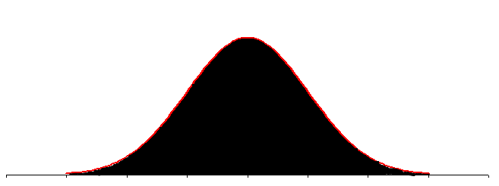
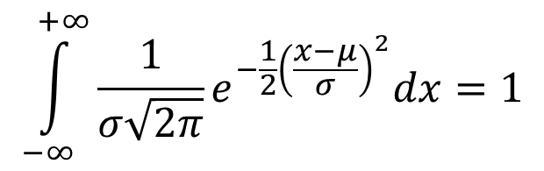
The Normal Density Function
It’s a probability function, so no matter what the
values of μ and σ, must integrate to 1!
$$\int_{−∞}^{+∞}{\frac{1}{σ\sqrt{2π}}e^{−\frac{1}{2}{\left(\frac{x−μ}{σ}\right)}^{2}}dx=1}$$

Slide 100
The Shape of Normal Density
Normal distribution is bell shaped, and symmetrical around m.
90
μ
110
Why symmetrical? Let µ = 100. Suppose x = 110.
Now suppose x = 90

Slide 101
Normal Probability Density
The expected value (also called the mean) E(X) (or μ) can be any number
The standard deviation σ can be any nonnegative number
The total area under every normal curve is 1
There are infinitely many normal distributions

Slide 102
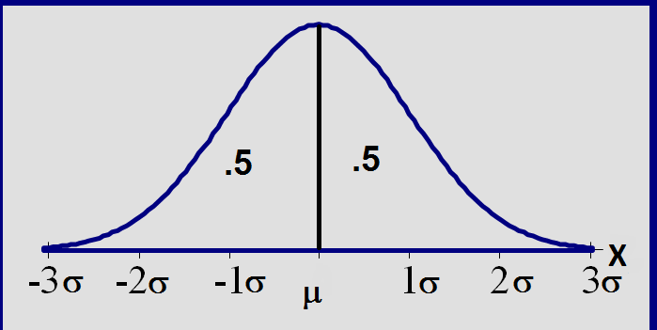
Total area =1; symmetric around µ
Normal Probability Density

Slide 103
The effects of μ and σ
How does the standard deviation affect the shape of f(x)?
σ= 2
σ =3
σ =4
How does the expected value affect the location of f(x)?
μ = 10
μ = 11
μ = 12

Slide 104
Statistical Measures

Slide 105
Statistical Measures
Center of the data
  Mean
  Median
Variation
  Range
  Quartiles
  Variance
  Standard Deviation
  Covariance
  Correlation

Slide 106
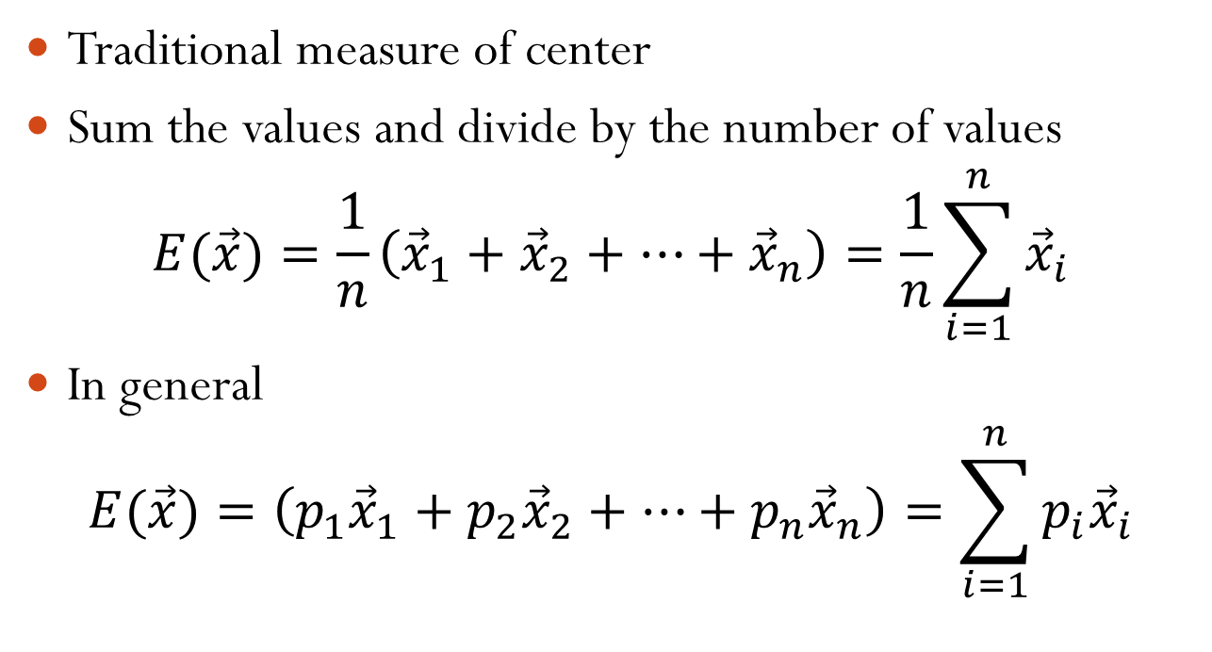
Mean or Average or Expectation
Traditional measure of center
Sum the values and divide by the number of values
$$E(\vec{x})=\frac{1}{n}\left({\vec{x}}_{1}+{\vec{x}}_{2}+…+{\vec{x}}_{n}\right)=\frac{1}{n}\sum_{i=1}^{n}{{\vec{x}}_{i}}$$
In general
$$E(\vec{x})=\left(p_{1}{\vec{x}}_{1}+p_{2}{\vec{x}}_{2}+…+{p_{n}\vec{x}}_{n}\right)=\sum_{i=1}^{n}{{p_{i}\vec{x}}_{i}}$$

Slide 107
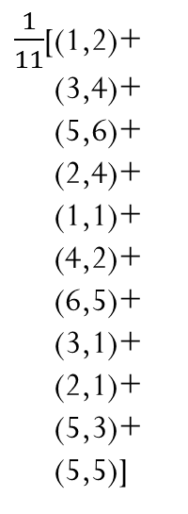
Mean or Average
$\frac{1}{11}$[(1,2)+
(3,4)+
(5,6)+
(2,4)+
(1,1)+
(4,2)+
(6,5)+
(3,1)+
(2,1)+
(5,3)+
(5,5)]
(5,6)
(6,5)
Mean
(2,4)
(3,4)
(5,5)
(3.3636,3.0909)
(5,3)
(2,1)
(4,2)
(1,1)
(1,2)
(3,1)

Slide 108
Median (M)
A resistant measure of the data’s center
At least half of the ordered values are less than or equal to the median value
At least half of the ordered values are greater than or equal to the median value
If n is odd, the median is the middle ordered value
If n is even, the median is the average of the two middle ordered values

Slide 109
Median (M)
Location of the median: L(M) = (n+1)/2 ,
where n = sample size.
Example: If 25 data values are recorded, the Median would be the
(25+1)/2 = 13th ordered value.

Slide 110
Median
Example 1 data: 2 4 6
  Median (M) = 4
Example 2 data: 2 4 6 8
  Median = 5 (average of 4 and 6)
Example 3 data: 6 2 4
  Median ≠ 2
  (order the values: 2 4 6 , so Median = 4)

Slide 111
Comparing the Mean & Median
Computation of mean is easier.
Finding median in higher dimension is much complex.
Mean is prone to noise.
The mean and median of data from a symmetric distribution should be close together. The actual (true) mean and median of a symmetric distribution are exactly the same.

Slide 112
Spread or Variability
If all values are the same, then they all equal to the mean. There is no variability.
  Eg: 2, 2, 2, 2, 2, 2; mean = 2
Variability exists when some values are different from (above or below) the mean.
  Eg: 10, 15,-20,-22,30, 22
We will discuss the following measures of spread: range, quartiles, variance, and standard deviation

Slide 113
Range
One way to measure spread is to give the smallest (minimum) and largest (maximum) values in the data set;
Range = max − min
  Eg: 10,-2,-7,22,0,11; Range = 22-(-7)=28
The range is strongly affected by outliers

Slide 114
Quartiles
Three numbers which divide the ordered data into four equal sized groups.
Q₁ has 25% of the data below it.
Q₂ has 50% of the data below it. (Median)
Q₃ has 75% of the data below it.

Slide 115
Quartiles Uniform Distribution
Q₁
Q₂
Q₃

Slide 116
Obtaining the Quartiles
Order the data.
For Q₂, just find the median.
For Q₁, look at the lower half of the data values, those to the left of the median location; find the median of this lower half.
For Q₃, look at the upper half of the data values, those to the right of the median location; find the median of this upper half.

Slide 117
Variance and Standard Deviation
Recall that variability exists when some values are different from (above or below) the mean.
Each data value has an associated deviation from the mean:

Slide 118
Deviations
what is a typical deviation from the mean? (standard deviation)
small values of this typical deviation indicate small variability in the data
large values of this typical deviation indicate large variability in the data

Slide 119
Variance
  Variance is the average squared deviation from the mean of a set of data. It is used to find the standard deviation.

Slide 120
Variance
Mean

Slide 121
Variance
2
-

Slide 122
Variance
2
-
2
-

Slide 123
Variance
1
2
2
----------------
………
+
-
+
-
+
………
No. of Data
Points

Slide 124
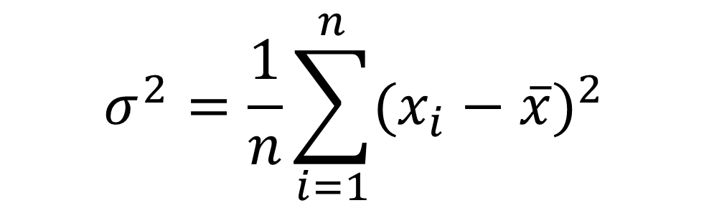
Variance Formula
$$σ^{2}=\frac{1}{n}\sum_{i=1}^{n}{{(x_{i}−\overline{x})}^{2}}$$

Slide 125
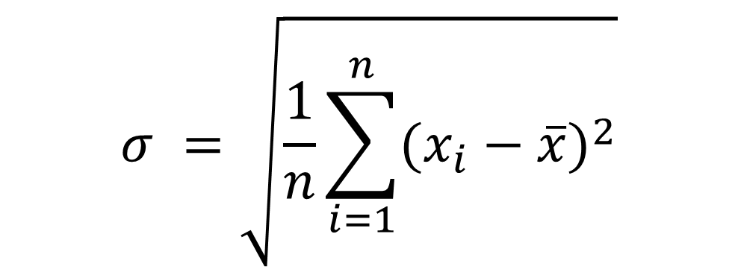
Standard Deviation
$$σ =\sqrt{\frac{1}{n}\sum_{i=1}^{n}{{(x_{i}−\overline{x})}^{2}}}$$
[ standard deviation = square root of the variance ]

Slide 126
Variance and Standard Deviation
Metabolic rates of 7 men (cal./24hr.) :
1792 1666 1362 1614 1460 1867 1439

Slide 127
Variance and Standard Deviation
Observations | Deviations | Squared deviations
1792 | 1792−1600 = 192 | (192)² = 36,864
1666 | 1666 −1600 = 66 | (66)² = 4,356
1362 | 1362 −1600 = -238 | (-238)² = 56,644
1614 | 1614 −1600 = 14 | (14)² = 196
1460 | 1460 −1600 = -140 | (-140)² = 19,600
1867 | 1867 −1600 = 267 | (267)² = 71,289
1439 | 1439 −1600 = -161 | (-161)² = 25,921
 | sum = 0 | sum = 214,870

Slide 128
Variance and Standard Deviation

Slide 129
Variance (2D)

Slide 130
Variance (2D)

Slide 131
Variance (2D)

Slide 132
Variance (2D)

Slide 133
Variance (2D)
Variance doesn’t explore
relationship between variables

Slide 134

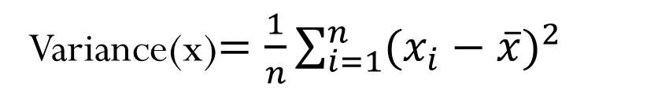
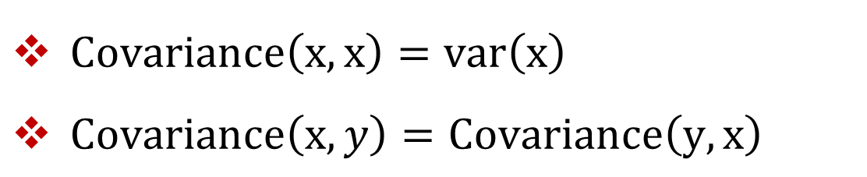
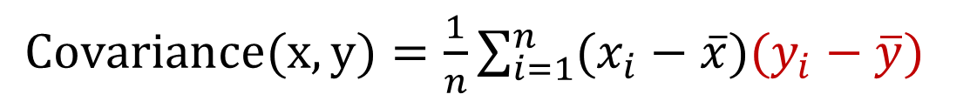
Covariance
Variance(x)$=\frac{1}{n}\sum_{i=1}^{n}{{(x_{i}−\overline{x})}^{2}}$
$=\frac{1}{n}\sum_{i=1}^{n}{(x_{i}−\overline{x})(x_{i}−\overline{x})}$
$Covariance(x,y)=\frac{1}{n}\sum_{i=1}^{n}{(x_{i}−\overline{x})(y_{i}−\overline{y})}$
$Covariance\left(x,x\right)=var\left(x\right)$
$Covariance\left(x,y\right)=Covariance\left(y,x\right)$

Slide 135
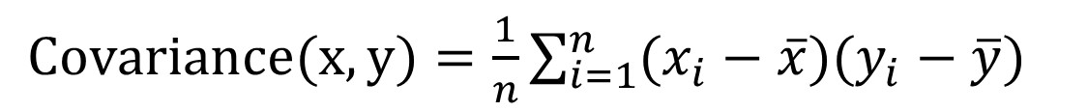
Covariance
$Covariance(x,y)=\frac{1}{n}\sum_{i=1}^{n}{(x_{i}−\overline{x})(y_{i}−\overline{y})}$

Slide 136
Covariance
$Covariance(x,y)=\frac{1}{n}\sum_{i=1}^{n}{(x_{i}−\overline{x})(y_{i}−\overline{y})}$

Slide 137






Covariance
$Covariance(x,y)=\frac{1}{n}\sum_{i=1}^{n}{(x_{i}−\overline{x})(y_{i}−\overline{y})}$
$$\overline{y}$$
$y_{1}−\overline{y}$<0
$$y_{1}$$
$$x_{1}$$
$$\overline{x}$$
$x_{1}−\overline{x}$<0

Slide 138




Covariance
$Covariance(x,y)=\frac{1}{n}\sum_{i=1}^{n}{(x_{i}−\overline{x})(y_{i}−\overline{y})}$
$$y_{1}$$
$y_{1}−\overline{y}>$0
$$\overline{y}$$
$$\overline{x}$$
$$x_{1}$$
$x_{1}−\overline{x}>$0

Slide 139



Covariance
$Covariance(x,y)=\frac{1}{n}\sum_{i=1}^{n}{(x_{i}−\overline{x})(y_{i}−\overline{y})}$
$(x_{i}−\overline{x})(y_{i}−\overline{y})$>0
$(x_{i}−\overline{x})(y_{i}−\overline{y})$<0
Positive
Relation
$(x_{i}−\overline{x})(y_{i}−\overline{y})$<0
$(x_{i}−\overline{x})(y_{i}−\overline{y})$>0

Slide 140
Covariance
$Covariance(x,y)=\frac{1}{n}\sum_{i=1}^{n}{(x_{i}−\overline{x})(y_{i}−\overline{y})}$

Slide 141
Covariance
$Covariance(x,y)=\frac{1}{n}\sum_{i=1}^{n}{(x_{i}−\overline{x})(y_{i}−\overline{y})}$

Slide 142






Covariance
$Covariance(x,y)=\frac{1}{n}\sum_{i=1}^{n}{(x_{i}−\overline{x})(y_{i}−\overline{y})}$
$$y_{1}$$
$y_{1}−\overline{y}>$0
$$\overline{y}$$
$$x_{1}$$
$$\overline{x}$$
$x_{1}−\overline{x}$<0

Slide 143




Covariance
$Covariance(x,y)=\frac{1}{n}\sum_{i=1}^{n}{(x_{i}−\overline{x})(y_{i}−\overline{y})}$
$$\overline{y}$$
$y_{1}−\overline{y}$<0
$$y_{1}$$
$$\overline{x}$$
$$x_{1}$$
$x_{1}−\overline{x}$>0

Slide 144


Covariance
$Covariance(x,y)=\frac{1}{n}\sum_{i=1}^{n}{(x_{i}−\overline{x})(y_{i}−\overline{y})}$
$\left(x_{i}−\overline{x}\right)\left(y_{i}−\overline{y}\right)<$0
$(x_{i}−\overline{x})(y_{i}−\overline{y})$>0
Negative
Relation
$(x_{i}−\overline{x})(y_{i}−\overline{y})$>0
$(x_{i}−\overline{x})(y_{i}−\overline{y})$<0

Slide 145
Covariance
$Covariance(x,y)=\frac{1}{n}\sum_{i=1}^{n}{(x_{i}−\overline{x})(y_{i}−\overline{y})}$

Slide 146



Covariance
$Covariance(x,y)=\frac{1}{n}\sum_{i=1}^{n}{(x_{i}−\overline{x})(y_{i}−\overline{y})}$
$\left(x_{i}−\overline{x}\right)\left(y_{i}−\overline{y}\right)<$0
$\left(x_{i}−\overline{x}\right)\left(y_{i}−\overline{y}\right)>$0
No
Relation
$\left(x_{i}−\overline{x}\right)\left(y_{i}−\overline{y}\right)<$0
$\left(x_{i}−\overline{x}\right)\left(y_{i}−\overline{y}\right)>$0

Slide 147



Covariance
$Covariance(x,y)=\frac{1}{n}\sum_{i=1}^{n}{(x_{i}−\overline{x})(y_{i}−\overline{y})}$
$$(x, y)$$
$$(x−\overline{x},y −\overline{y})$$
(2 , 1)
(2 , 2)
(4 , 3)
(6 , 1)
(8 , 3)
(1 , 5)
(4 , 6)
(4 , 7)
(6 , 3)
(6 , 5)
(6 , 6)
(-2.4545, -2.8182)
(-2.4545, -1.8182)
(-0.4545, -0.8182)
(1.5455, -2.8182)
(3.5455, -0.8182)
(-3.4545, 1.1818)
(-0.4545, 2.1818)
(-0.4545, 3.1818)
(1.5455, -0.8182)
(1.5455, 1.1818)
(1.5455, 2.1818)
$Covariance(x,y)=\frac{1}{11}{(x−\overline{x})}^{T} (y−\overline{y})$
$Covariance(x,y)=E[{\left(x−\overline{x}\right)}^{T} \left(y−\overline{y}\right)]$
(4.4545, 3.8182)
(0, 0)

Slide 148
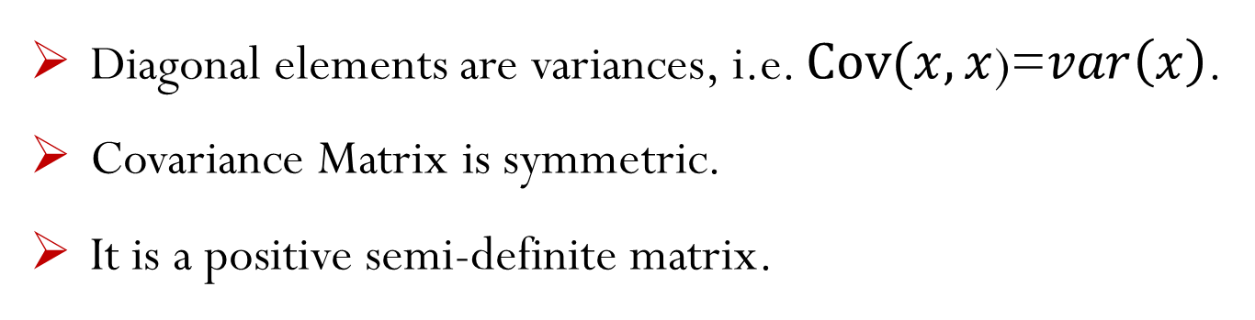
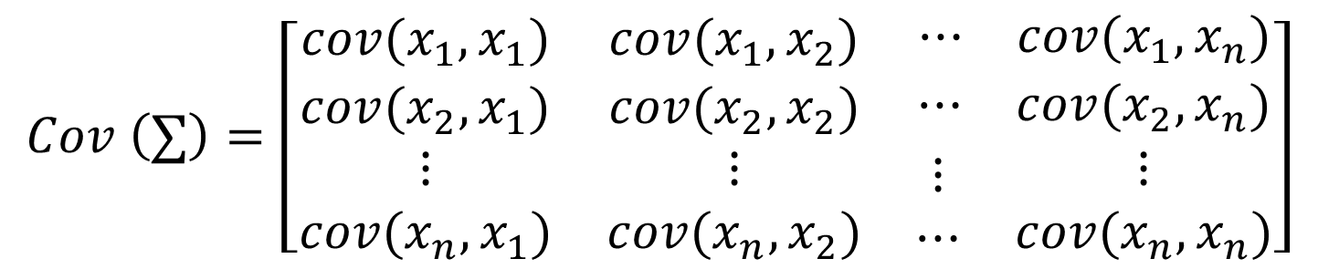
Covariance Matrix
$$Cov \left(∑\right)=\left[\begin{matrix}cov(x_{1},x_{1}) & cov(x_{1},x_{2}) & \begin{matrix}⋯ & cov(x_{1},x_{n})\end{matrix} \\ cov(x_{2},x_{1}) & cov(x_{2},x_{2}) & \begin{matrix}⋯ & cov(x_{2},x_{n})\end{matrix} \\ \begin{matrix}⋮ \\ cov(x_{n},x_{1})\end{matrix} & \begin{matrix}⋮ \\ cov(x_{n},x_{2})\end{matrix} & \begin{matrix}\begin{matrix}⋮ \\ ⋯\end{matrix} & \begin{matrix}⋮ \\ cov(x_{n},x_{n})\end{matrix}\end{matrix}\end{matrix}\right]$$
Diagonal elements are variances, i.e. $Cov(x,x$)=$var\left(x\right)$.
Covariance Matrix is symmetric.
It is a positive semi-definite matrix.

Slide 149
Correlation
Positive relation
Negative relation
No relation
Covariance determines whether relation is positive or negative, but it was impossible to measure the degree to which the variables are related.
Correlation is another way to determine how two variables are related.
In addition to whether variables are positively or negatively related, correlation also tells the degree to which the variables are related each other.

Slide 150
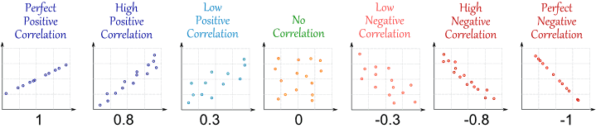

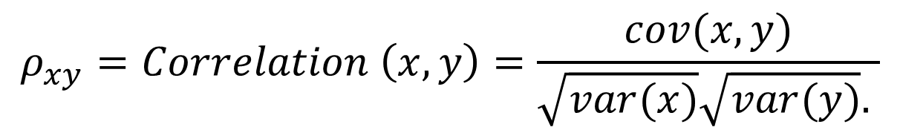
Correlation
$$ρ_{xy}=Correlation \left(x,y\right)=\frac{cov(x,y)}{\sqrt{var(x)}\sqrt{var(y)}. }$$
$$−1≤Correlation\left(x,y\right)≤+1$$

Slide 151
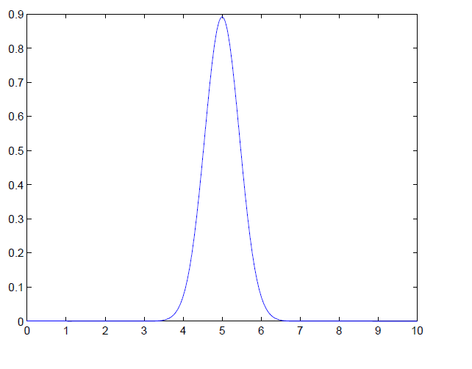
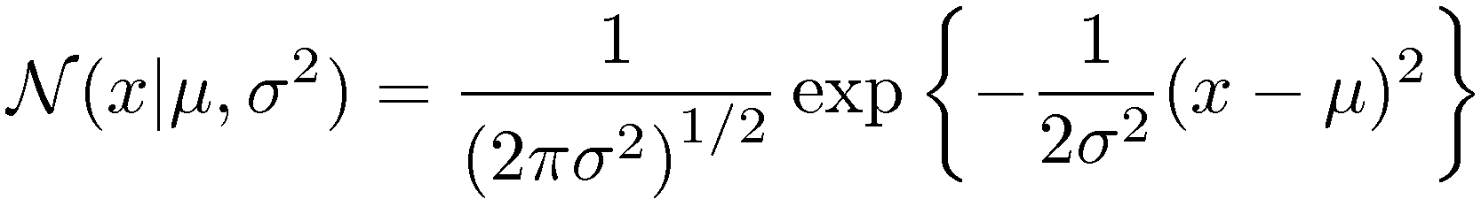
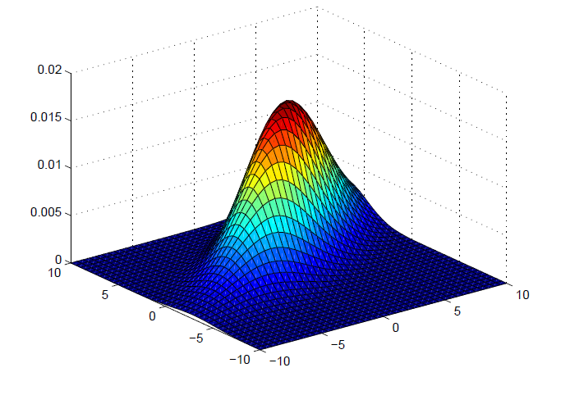
Multivariate Gaussians (or "multinormal distribution“ or “multivariate normal distribution”)
Univariate case: single mean μ and
variance σ
Multivariate case:
Vector of observations x,
vector of means μ and covariance matrix Σ
Dimension of x
Determinant

Slide 152
Multivariate Gaussians
Univariate case
Multivariate case
do not depend on x
normalization constants
depends on x and positive

Slide 153
The mean vector

Slide 154
Covariance of two random variables
Recall for two random variables x_{i}, x_{j}

Slide 155
The covariance matrix
transpose operator
Var(x_{m})=Cov(x_{m}, x_{m})

Slide 156
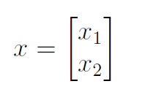

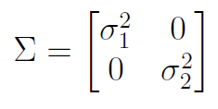
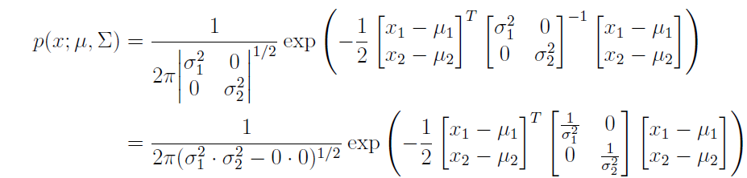
An example: 2 variate case
The pdf of the multivariate will be:
Covariance matrix
Determinant

Slide 157
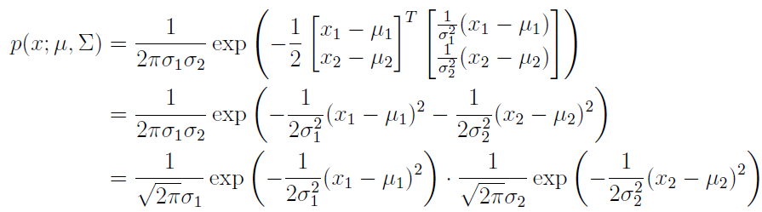
An example: 2 variate case
Factorized into two independent Gaussians!
They are independent!
Recall in general case independence implies uncorrelation
but uncorrelation does not necessarily implies independence.
Multivariate Gaussians is a special case where uncorrelation
implies independence as well.

Slide 158
Diagonal covariance matrix
If all the variables are independent from each other,
The covariance matrix will be an diagonal one.
Reverse is also true:
If the covariance matrix is a diagonal one they are independent
Diagonal matrix: m matrix where off-diagonal terms are zero

Slide 159
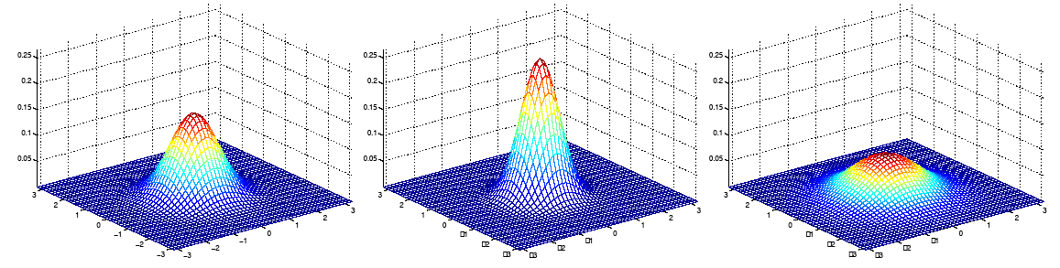
Gaussian Intuitions: Size of Σ
Identity matrix
μ = [0 0] μ = [0 0] μ = [0 0]
= I Σ = 0.6I Σ = 2I
As Σ becomes larger,
Gaussian becomes more spread out

Slide 160
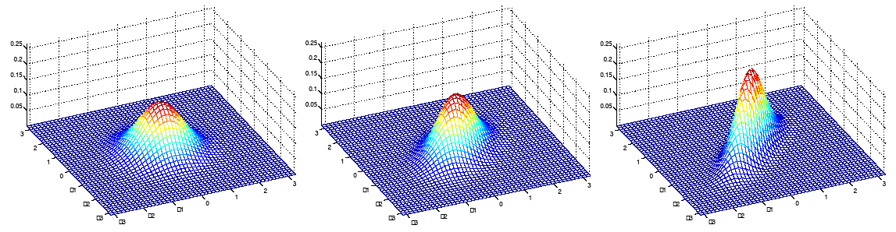
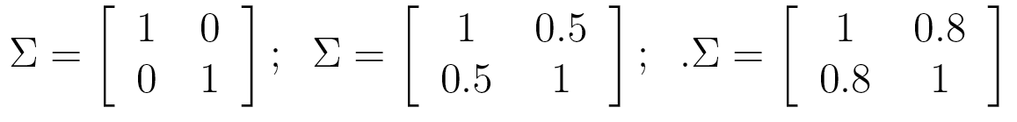
Gaussian Intuitions: Off-diagonal
As the off-diagonal entries increase, more correlation between value of x and value of y

Slide 161
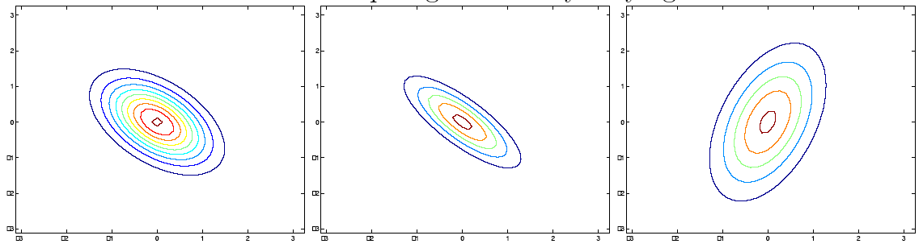
Gaussian Intuitions: off-diagonal and diagonal
Decreasing non-diagonal entries (#1-2)
Increasing variance of one dimension in diagonal (#3)

